Slide 1
Topic: Dividing Fractions
EQ: How do we divide fractions?
Ms. Latham

Slide 2



Topic: Dividing Fractions
EQ: How do I divide fractions?
reciprocal
To find the reciprocal of a fraction you must invert the fraction. This is done by swapping the numerator and the denominator. ‘flipping the fraction’
Glossary Alert!!
Dividing by a fraction
Dividing by a fraction is the same as multiplying by the reciprocal
$$\frac{2}{3}÷\frac{1}{2}$$
$$=\frac{2}{3}×\frac{2}{1}$$
$$= \frac{2×2}{3×1}=\frac{4}{3} = 1\frac{1}{3}$$
Mixed numbers must be changed to improper fractions

Slide 3
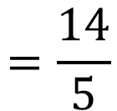
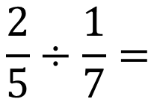
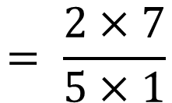



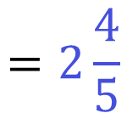
Topic: Dividing Fractions
EQ: How do I divide fractions?
Keep
Flip
Change
$$\frac{2}{5}÷\frac{1}{7}=$$
$$\frac{2}{5}$$
$$\frac{7}{1}$$
$$= \frac{2×7}{5×1}$$
$$=\frac{14}{5}$$
$$=2\frac{4}{5}$$
$$×$$

Slide 4

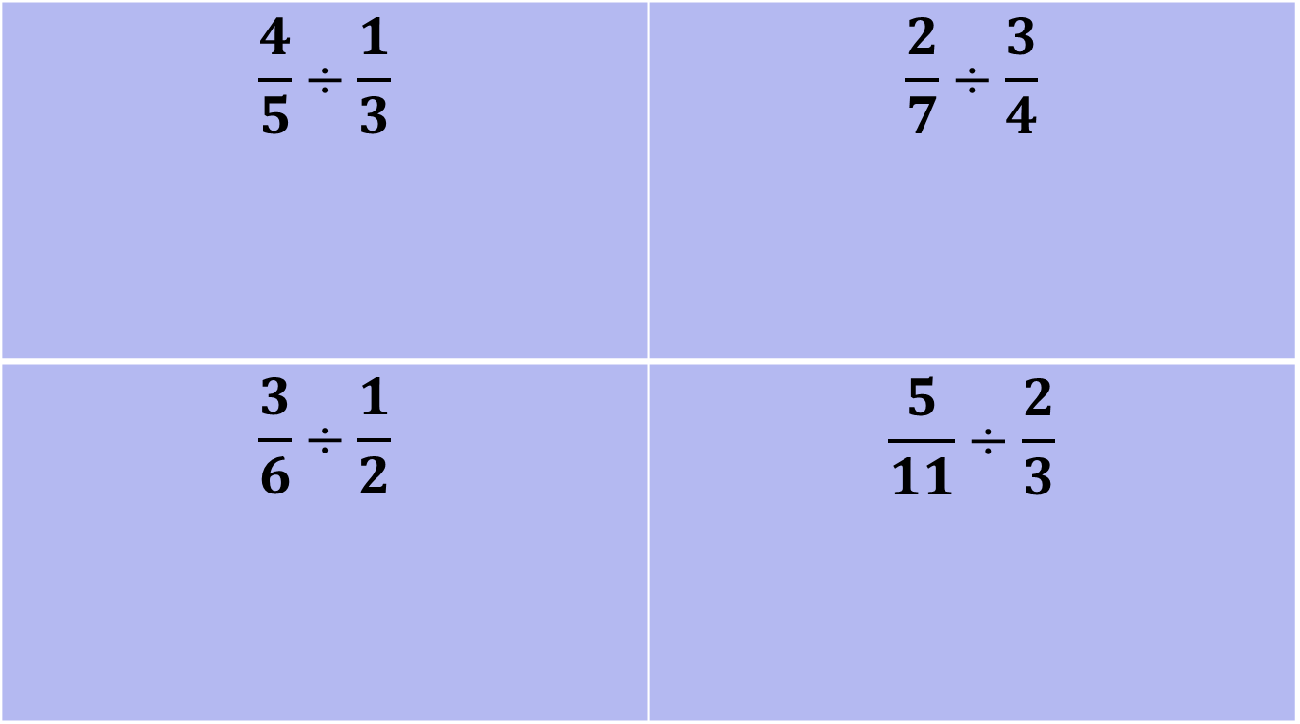
Practice Time!
On your left hand side
$$\frac{4}{5}÷\frac{1}{3}$$ | $$\frac{2}{7}÷\frac{3}{4}$$
$$\frac{3}{6}÷\frac{1}{2}$$ | $$\frac{5}{11}÷\frac{2}{3}$$
Have Sum Fun – Sum Funs 39

Slide 5
Summary
To divide fractions we…….

